Slide 1


From Insight to Action

Slide 2
Supercharging Modernization:
Connecting People to IT Transformation
Kimberly J. Droniak
ERP Systems Analyst, SaaS Project Change Management Lead
Quinnipiac University
Samantha Kessler
Senior Principal Strategic Specialist
Ellucian
August 7, 2026
Notes:
Introduction 4mins
Ellucian introduction 5-7mins
QU content 24mins
Questions/Closing 5 mins

Slide 3
Change Management Enables Successful SaaS Modernization
Technical Side
Project Management
People Side
Change Management
⭐Business Value Realized
On-time delivery
On-budget
Solution and features implemented
➡️ System is LIVE
Clear and understood why; alignment on project objectives
Stakeholder engagement, enablement, and support
➡️High adoption, behavior change, consistency and streamlining
➡️ Faster time to value
➡️ Achieved and sustained outcomes
➡️ Return on investment (ROI)
We realize value when people adopt.

Slide 4
Our Change Management Process: A Structured and Collaborative Approach
Assessment
Defining the Why and Success
Plan & Prepare
Understand the organization’s current state and readiness for change; assess the impact of change on stakeholders
Develop strategies to prepare stakeholders for the transition; Orient key leaders to change management roles
Align key stakeholders on why this change is occurring, benefits of SaaS, and outcomes of the project.
Enable
Sustain
Continuous Improvement
Equip stakeholders with the knowledge, skills, and support needed for adoption.
Reinforce adoption and help the institution realize long-term value.
Structures for ongoing stakeholder engagement, continuous optimization as SaaS evolves.
Notes:
SK: talk about ADKAR as a driving framework.

Slide 5
Change Management is Embedded in the Project Lifecycle
Discovery
Sponsor and leadership alignment
Design and Development
Stakeholder impact assessment
Configure and Validate
Support for testing and business simulation
Deploy/Go-Live
Go-Live plan and communications
Stakeholder identification
Change management and communication strategy
Governance planning
Stakeholder engagement
Ongoing communication
Final readiness assessment
End user training plan
Reinforcement strategy
Adoption measurement

Slide 6

Building a Strong Engine |
Quinnipiac’s Transformation
QU | Vision & Goals
  Fierce commitment
  Community passion
  Bold future
  Living the mission for long-lasting success
Project Scope
  Modern, transformational technology
  Kick-off late 2025 with pending implementation into 2027
.
Bobcat Impact
  Staff, faculty, students
  Functional Areas & Leadership
  New Solutions & Services
  (Self-Service, EIP, Insights, modernizations, training, & more!)
Project Team
  Sponsor
  Steering Committee
  Project Teams (QU & Ellucian)
  Functional Leads & Teams
  Key Leadership
NERUG 2026 Annual Summer Conference · Framingham State University

Slide 7

Supercharge Change Management
Change Management Lead
  Designate internal university role
  Expansive skill set
  “People Person”
  Community Dedication
  Relatable & empathetic
  Culture-focused
  Training experience
.
Engagement
  Availability & Visibility
  Personalized Support
  “Cheerleader”
  “Pedal to the Metal”
  Adaptation to “Bells & Whistles”
  Build rapport & relationships
NERUG 2026 Annual Summer Conference · Framingham State University

Slide 8
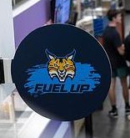
Fuel Up! Building Awareness and Knowledge
Regular | Mid-Grade | Premium | Diesel
  Understanding - “What’s in it for me?”
  Considerations - workload, required operations, staffing constraints
  Adaptations - scheduling, seasonal operations, team skills/experience
Affordable Choices
  Clear, user-centered messaging
  Culture & Operations | Customization & Continuity
  Highlight “driver” impacts,
  Advanced solutions & benefits
NERUG 2026 Annual Summer Conference · Framingham State University

Slide 9
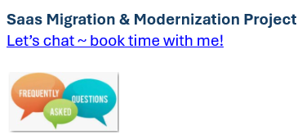
Diagnose, Repair & Test Drive
Availability & Access
  Partner-preferred locations
    Multiple campuses
    Comfortable spaces
  Offer open schedule
    Bookings, Outlook, Calendly, etc.
  “Check Engine” – user adoption
  Audience-specific guidance
.
“Top-of-the-Line” Tools
  Website
  Zoom & In-Person Offerings
  Newsletter, MyQ, Experience
  Support Survey
  Education & Training
  Active Listening
NERUG 2026 Annual Summer Conference · Framingham State University

Slide 10

Regular Maintenance → Crossing the Finish Line
→ Long-lasting IT Adventures
1
2
3
Diagnose Gaps
User understanding
Engagement
Education & Training
Adoption
Support Needs
Translate Project Updates
Clear, user-centered messaging
Highlight community impacts
Relevancy to university mission & vision
Strategy Application
Embed people-focused change practices
Gain engagement “speed”
Maintain momentum
Plan for future change
NERUG 2026 Annual Summer Conference · Framingham State University

Slide 11
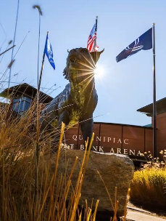
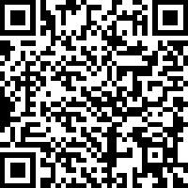
Questions?
Kimberly.Droniak@quinnipiac.edu
Samantha.Kessler@ellucian.com
Submit a question
or
stay connected here!
Notes:
Do you want a QR code – goes to a form to leave this info and someone will connect
Add emails

