Slide 1


From Insight to Action

Slide 2
Using Ellucian CRM Recruit for New Student Onboarding Success
Samantha Plourd, Dean of Enrollment, Retention & Completion; Springfield Technical Community College
Casey Malone, Solution Architect; Ferrilli Inc.
Jessica Rivera, EDP Processor III; Springfield Technical Community College

Slide 3
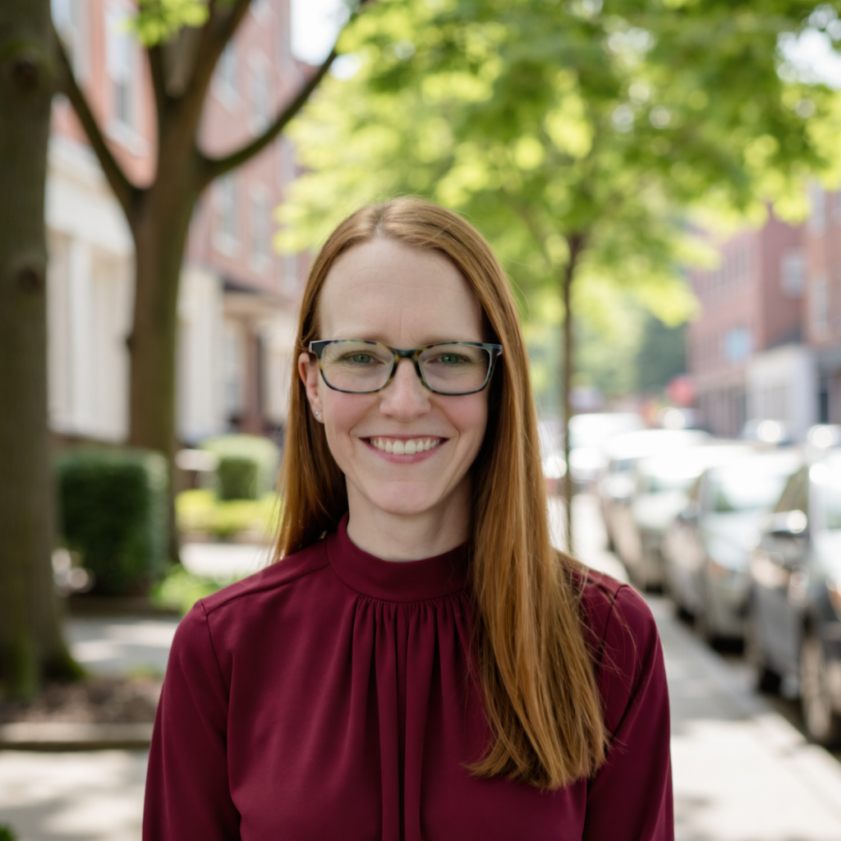
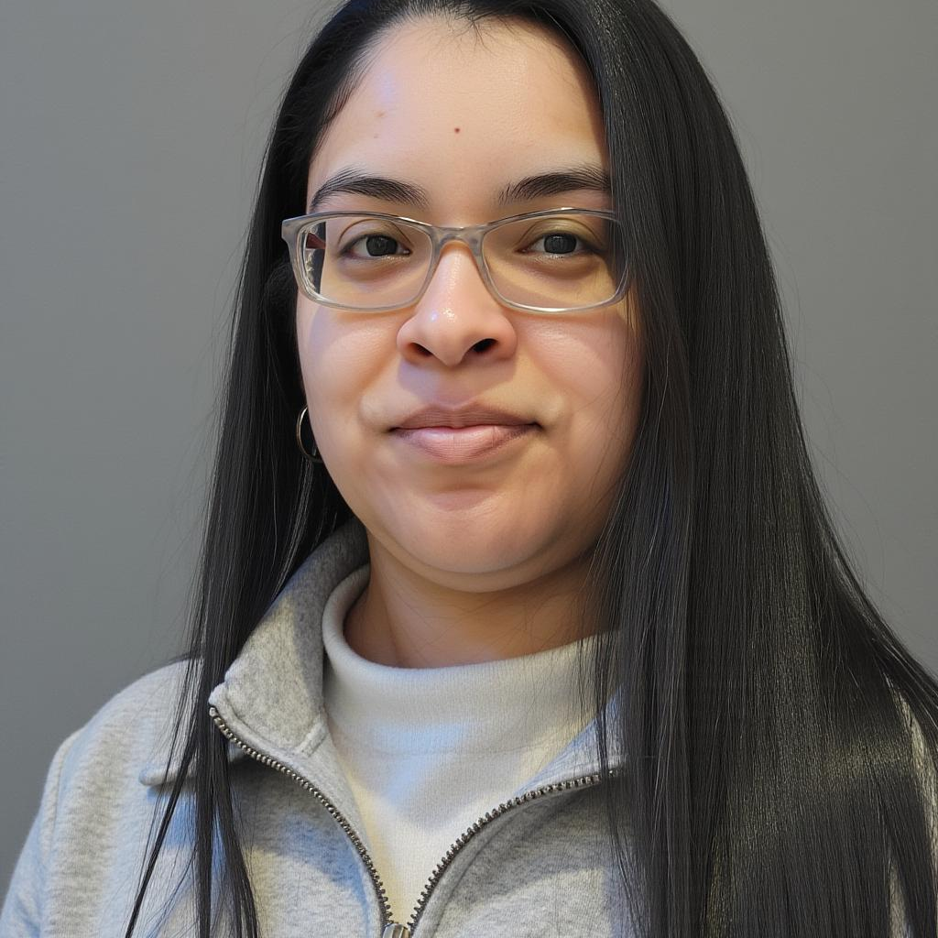
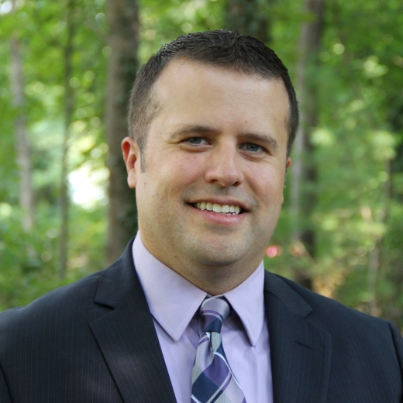
Samantha Plourd
Jessica Rivera
Casey Malone
Dean of Enrollment, Retention & Completion
Springfield Technical Community College
EDP Processor III
Springfield Technical Community College
Solution Architect
Ferrilli

Slide 4
AGENDA
1 Springfield Technical Community College
2 Onboarding Before CRM Recruit
3 Our Solution
4 The Impacts
5 Future Forward Thinking
NERUG 2026 Annual Summer Conference · Framingham State University
Notes:
CONTENT (single column) — Replace the title and use the body area for text, bullets, an image, or a chart. Delete the dashed box before presenting.

Slide 5
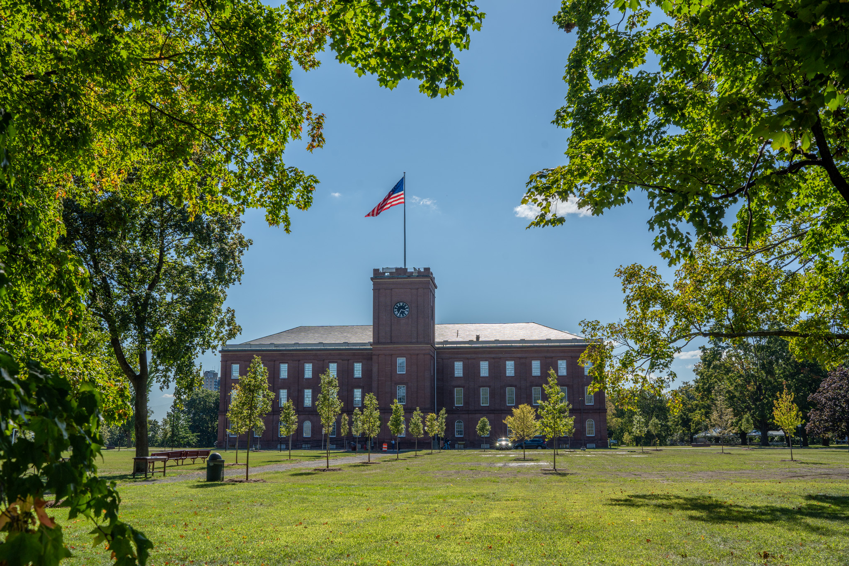
Springfield Technical Community College
Only Technical Community College in Massachusetts
  Open Access
  Large enrollment growth over the past few years due to Free Community College program
6,000 students per semester on the credit side
Diverse population
Hispanic Serving Institution
Located on the Springfield Armory National Historic Site
Right column
A supporting image, chart, or more text.
NERUG 2026 Annual Summer Conference · Framingham State University
Notes:
CONTENT (two column) — Good for text-and-image, comparisons, or before/after. Delete the dashed boxes before presenting.

Slide 6

Ferrilli has proudly served the higher education sector for 22 years. Founded in 2003 by Robert Ferrilli, our company addresses the unique IT needs of educational institutions. We have successfully partnered with nearly five hundred institutions across the U.S., including 2-year and 4-year colleges, private and public universities, medical schools, and graduate schools. As a dedicated IT partner focused exclusively on higher education, we prioritize innovations that enhance institutional efficiency and enrich the experiences of students, faculty, and staff.
NERUG 2026 Annual Summer Conference · Framingham State University
Notes:
VISUAL / DEMO — For a full-width screenshot, diagram, or demo. Replace the dashed box with your media and edit the caption.

Slide 7

New Student Onboarding Prior to CRM Recruit
Student Experience
Paper-based checklist distributed by email
Students tracking their own progress manually
No real-time status visibility
Staff Experience
Managed with spreadsheets
Reports from various systems
Highly manual processes
NERUG 2026 Annual Summer Conference · Framingham State University
Notes:
CONTENT (single column) — Replace the title and use the body area for text, bullets, an image, or a chart. Delete the dashed box before presenting.

Slide 8

NERUG 2026 Annual Summer Conference · Framingham State University
Notes:
VISUAL / DEMO — For a full-width screenshot, diagram, or demo. Replace the dashed box with your media and edit the caption.

Slide 9
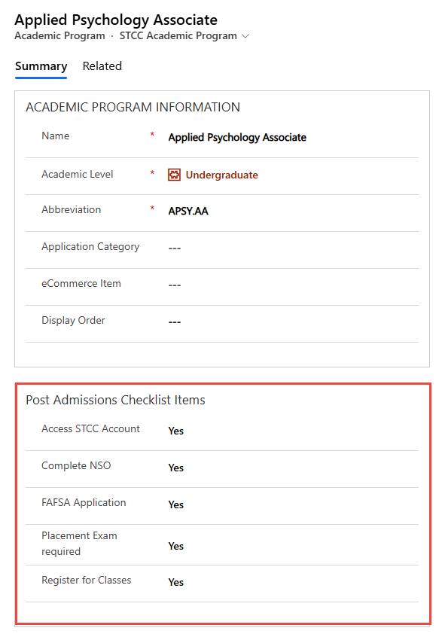
Initiating the New Student
Onboarding Process
Workflow (triggered on Admitted Date)
  Assigns the post-admission items based on established criteria:
    Student Type and Academic Program
    Field designating required Placement Exams (English and Math)
    Leverage custom fields on the Academic Program to control requirements by program
  Sends the initial New Student Onboarding email
Right column
A supporting image, chart, or more text.
NERUG 2026 Annual Summer Conference · Framingham State University
Notes:
CONTENT (two column) — Good for text-and-image, comparisons, or before/after. Delete the dashed boxes before presenting.

Slide 10
New Student Onboarding Items at STCC
Access Your STCC Account
Complete New Student Orientation
Complete Free Application for Student Aid
Immunization Form
English Self Placement Exam
Math Placement Exam
Keyboarding Exam Needed
Testing Not Required
Schedule an Appointment with An Advisor
NERUG 2026 Annual Summer Conference · Framingham State University
Notes:
CONTENT (single column) — Replace the title and use the body area for text, bullets, an image, or a chart. Delete the dashed box before presenting.

Slide 11
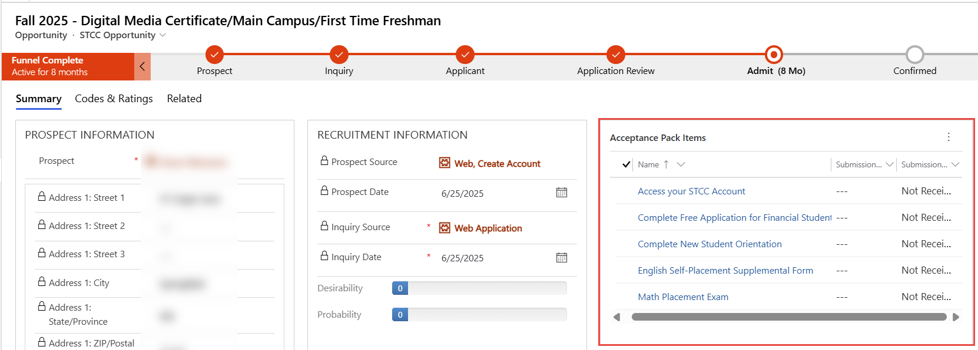
Managing Onboarding Items in Recruit
NERUG 2026 Annual Summer Conference · Framingham State University
Notes:
CONTENT (single column) — Replace the title and use the body area for text, bullets, an image, or a chart. Delete the dashed box before presenting.

Slide 12
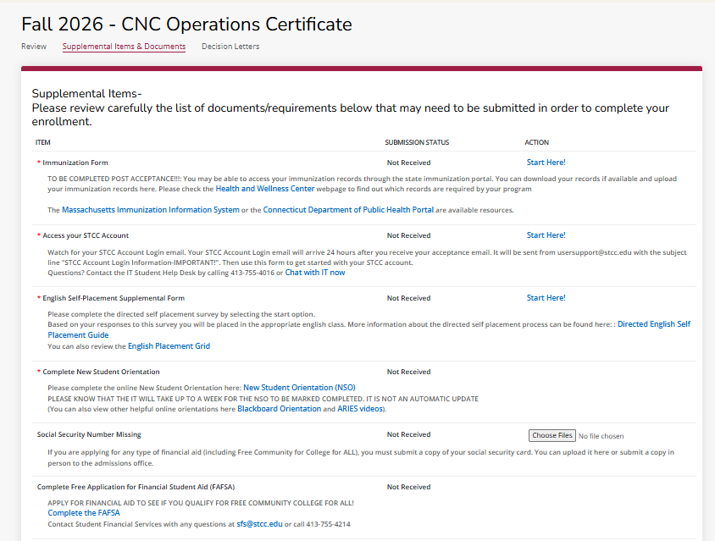
Displaying Onboarding Items on the CX
A workflow process runs on the pre-admission supplemental items and appends a “tag” to the value in the Web External Description
  Example: <span class="stcc_submissionhidden"></span>
Utilize custom JavaScript on the CX to:
  Identify the pre-admission items with the “tag”
  Hide those items from display on the CX
Result: Only the New Student Onboarding Items remain visible on the CX.
NERUG 2026 Annual Summer Conference · Framingham State University
Notes:
CONTENT (single column) — Replace the title and use the body area for text, bullets, an image, or a chart. Delete the dashed box before presenting.

Slide 13
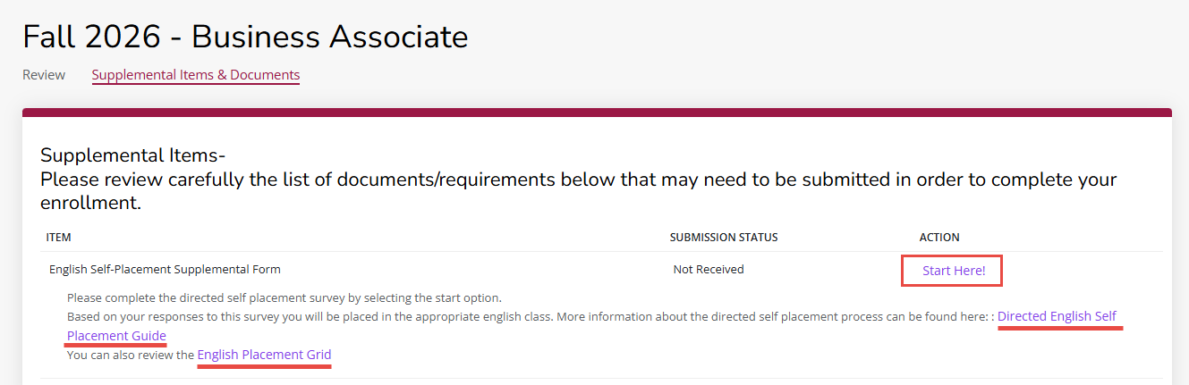
Self-Placement Exams - CX
NERUG 2026 Annual Summer Conference · Framingham State University
Notes:
CONTENT (single column) — Replace the title and use the body area for text, bullets, an image, or a chart. Delete the dashed box before presenting.

Slide 14
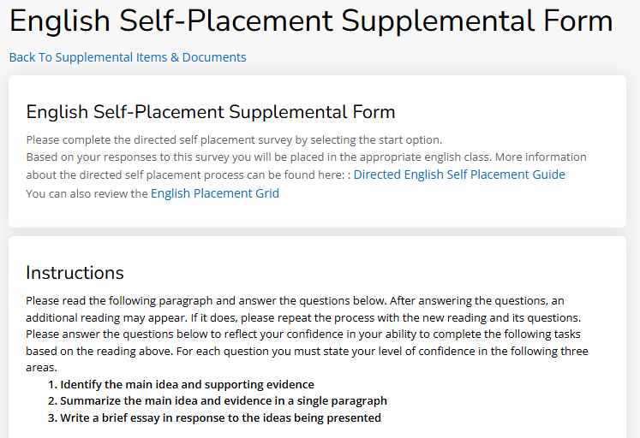
Self-Placement Exams - CX
Uses a Supplemental Item Submission Form
Logic displays additional questions based on student responses
Once the student completes the questionnaire a recommended English placement is emailed to the student
Test and Subtest scores are created in Recruit and sent to Colleague
NERUG 2026 Annual Summer Conference · Framingham State University
Notes:
CONTENT (single column) — Replace the title and use the body area for text, bullets, an image, or a chart. Delete the dashed box before presenting.

Slide 15
Import of NSO Completion
New Student Orientation is tracked in Qualtrics
Configured a process to:
  Import the NSO Completion data into Recruit
  Associate the Person based on ERP ID
  Create an Item Received record for the Complete NSO Supp Item
NERUG 2026 Annual Summer Conference · Framingham State University
Notes:
CONTENT (single column) — Replace the title and use the body area for text, bullets, an image, or a chart. Delete the dashed box before presenting.

Slide 16
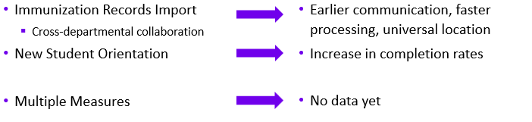
Other Post-Admit Checklist Items
NERUG 2026 Annual Summer Conference · Framingham State University
Notes:
CONTENT (single column) — Replace the title and use the body area for text, bullets, an image, or a chart. Delete the dashed box before presenting.

Slide 17

Initiating the New Student
Onboarding Process
New Student Orientation:
  Completion up 9 points in one year (72% -> 81%)
FAFSA:
  Completion rate 75% for year one
Right column
A supporting image, chart, or more text.
NERUG 2026 Annual Summer Conference · Framingham State University
Notes:
CONTENT (two column) — Good for text-and-image, comparisons, or before/after. Delete the dashed boxes before presenting.

Slide 18
Power in Changes
Internal
Students
Communication
Barriers
Reduction in excel spreadsheets
Staff time reduction
Earlier engagement
Cross-team coordination improvements
Access to real-time status
Easier access to student onboarding processes
Less confusion
Clear and timely communication to students
Real-time tracking to data
Customized language
Self-advocacy
Giving students more power
Works on THEIR timeline
NERUG 2026 Annual Summer Conference · Framingham State University

Slide 19
Future Forward
1
2
3
Multiple Measures
Communications
Inter-STCC Collaboration
New outcomes.
Upgrading to make more personable.
Where else can we improve?
NERUG 2026 Annual Summer Conference · Framingham State University
Notes:
KEY TAKEAWAYS — Summarize 3 things the audience should remember. Use fewer blocks if needed.

Slide 20
Questions?
Samantha Plourd, Dean of Enrollment, Retention & Completion
seplourd2201@stcc.edu

